Slide 1
Poster # P9
Count-Free Histograms with Race Logic for Single-Photon LiDAR
Atul Ingle, David Maier
Portland State Computational Imaging Lab
https://computational.camera/EDPHi

Slide 2
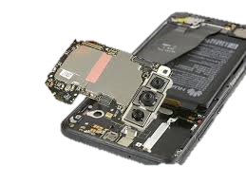
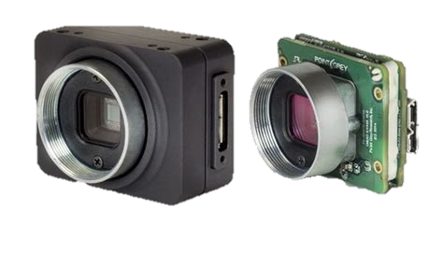
Single-Photon Sensors: Promising Features
single photon
25ºC
Extreme sensitivity
Room temperature operation
CMOS compatible; low cost
Notes:
Image sensors capable of detecting individual photons have the recently emerged as sensors of choice for low power, high resolution time-of-flight 3d imaging.
Cameras that use single-photon avalanche diodes provide extreme sensitivity, room temperature operation and low cost thanks to their compatibility with CMOS.

Slide 3
Single-Photon LiDAR: Data Bottleneck
$$30\frac{\text{frames}}{\text{sec}}$$
$${10}^{6}\frac{\text{pixels}}{\text{frame}}$$
$$1\frac{\text{histogram}}{\text{pixel}}$$
$$1000\frac{\text{bins}}{\text{histogram}}$$
$$1\frac{\text{byte}}{\text{bin}}$$
$$×$$
$$×$$
$$×$$
$$×$$
$$30\frac{\text{GB}}{\text{sec}}$$
$$=$$
Image Sensor
Off-sensor Compute
Bottleneck
Notes:
Unfortunately, their extreme sensitivity and time resolution come at a cost: the amount of raw photon data far exceeds the bandwidth of any existing data buses causing a severe bottleneck between the image sensor and off -sensor compute module.

Slide 4
Count-Free Single-Photon LiDAR [Proposed]
Key Ingredient #1: Race Logic
Key Ingredient #2: Equi-Depth Histograms
Encode signal values in terms of their delays.
Avoid expensive time-to-digital conversion.
Adaptively capture “peaky” distributions.
Avoid storing history of photon arrival timestamps and counts.
Notes:
We propose a count -free method for single photon 3d imaging. Our method relies on two key ingredients: race logic and equidepth histograms.
Race logic is a computing paradigm that encodes information in terms of time delays.
Equidepth histograms adaptively capture the laser peak location without the need for storing photon count history.

Slide 5
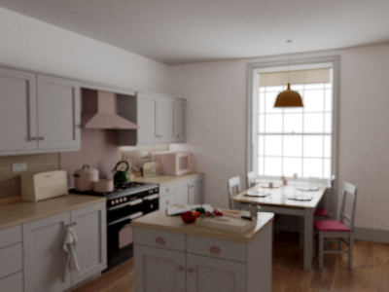
Result
RGB Image (rendered)
Notes:
Here's an example result. This is the scene in an RGB image.

Slide 6
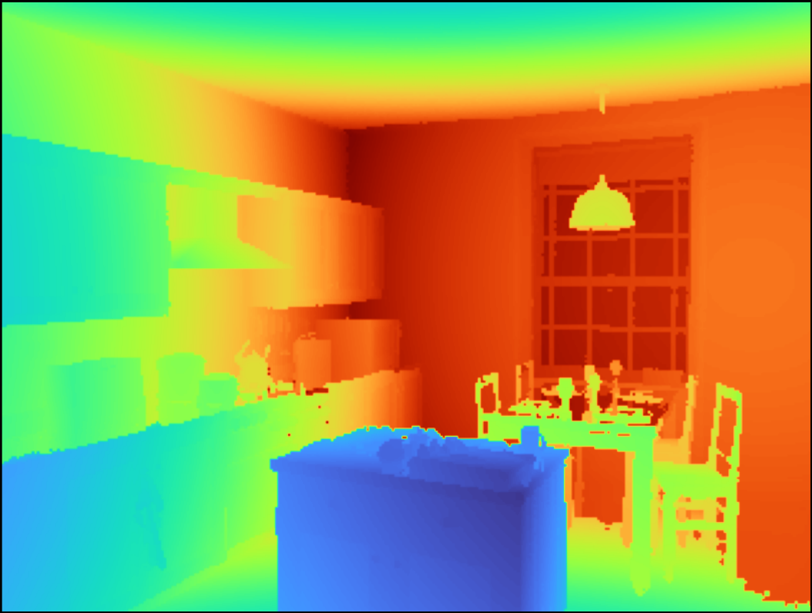
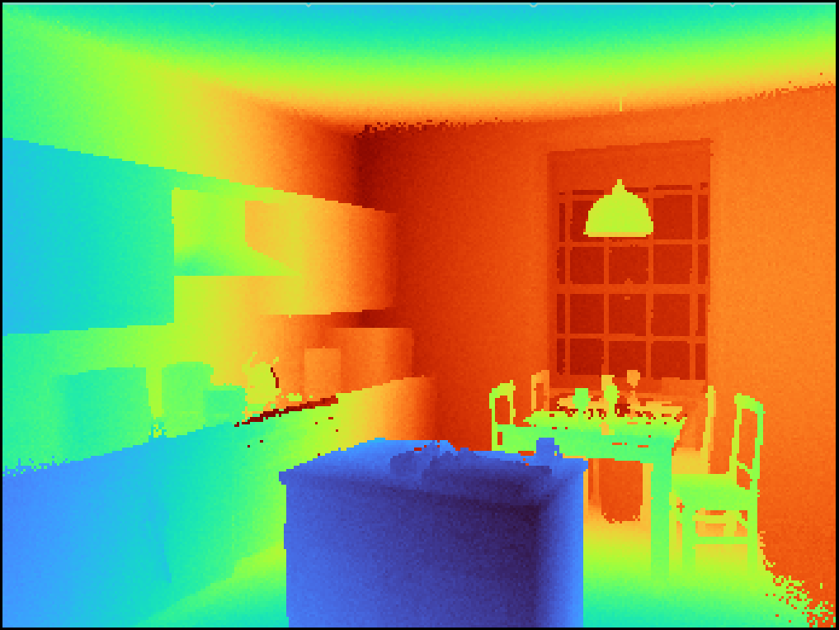
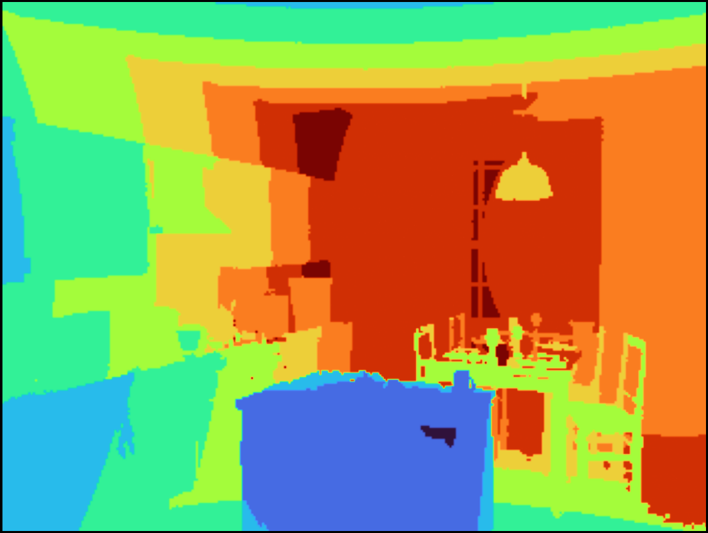
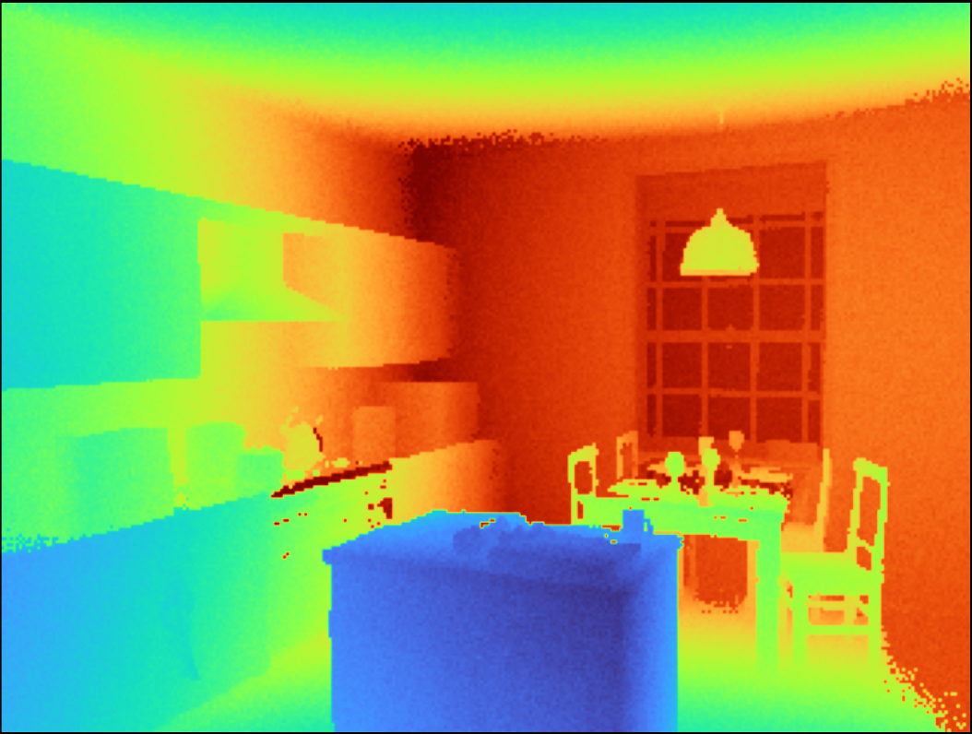
Result
Ground Truth Distances
Conventional 2000-bin Histograms
Coarse 16-bin Histograms
16-bin EDH [Ours]
strong quantization noise
details preserved
1.5
(m)
3.5
20
20 GB/s
15
Bandwidth GB/s
10
0.2 GB/s
0.2 GB/s
5
0
Notes:
Ground truth distances, traditional histogram-based method that requires 20 GB/s;
Coarser histogram bins reduces the data rate but causes strong quantization artifacts.
Our method preserves 3D details while requiring orders of magnitude less data.

Slide 7
Poster # P9
High resolution single-photon LiDAR at
100x lower bandwidth.
Notes:
Please visit Poster P9 for more!

